Slide 1
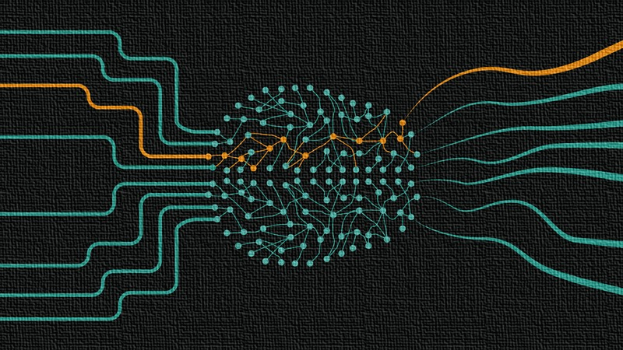
Neural Networks
Özgür Martin

Slide 2
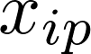
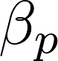
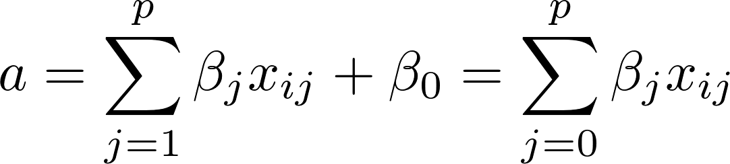
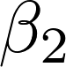
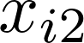
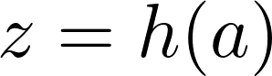
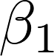
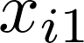

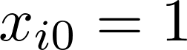
Processing Units
activation
. . .
. . .
activation function
bias parameter
Neural Networks
Özgür Martin

Slide 3

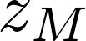

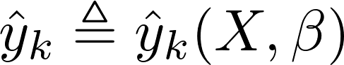
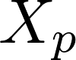
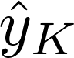
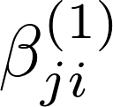
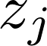
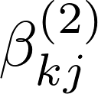
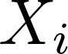
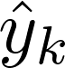
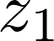
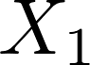
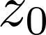
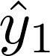
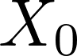
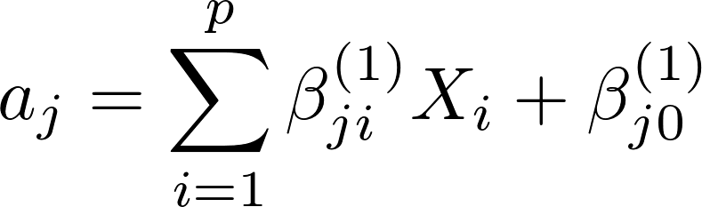
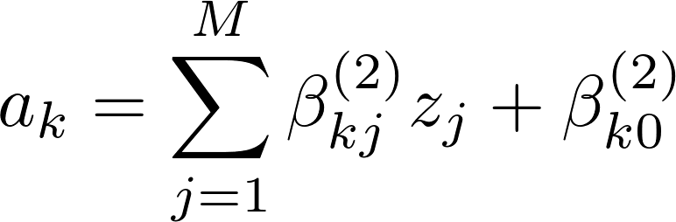
Three-Layer (Feed-Forward) Neural Network
. . .
. . .
. . .
. . .
. . .
. . .
Hidden Layer
output unit
activation function
Neural Networks
Özgür Martin

Slide 4
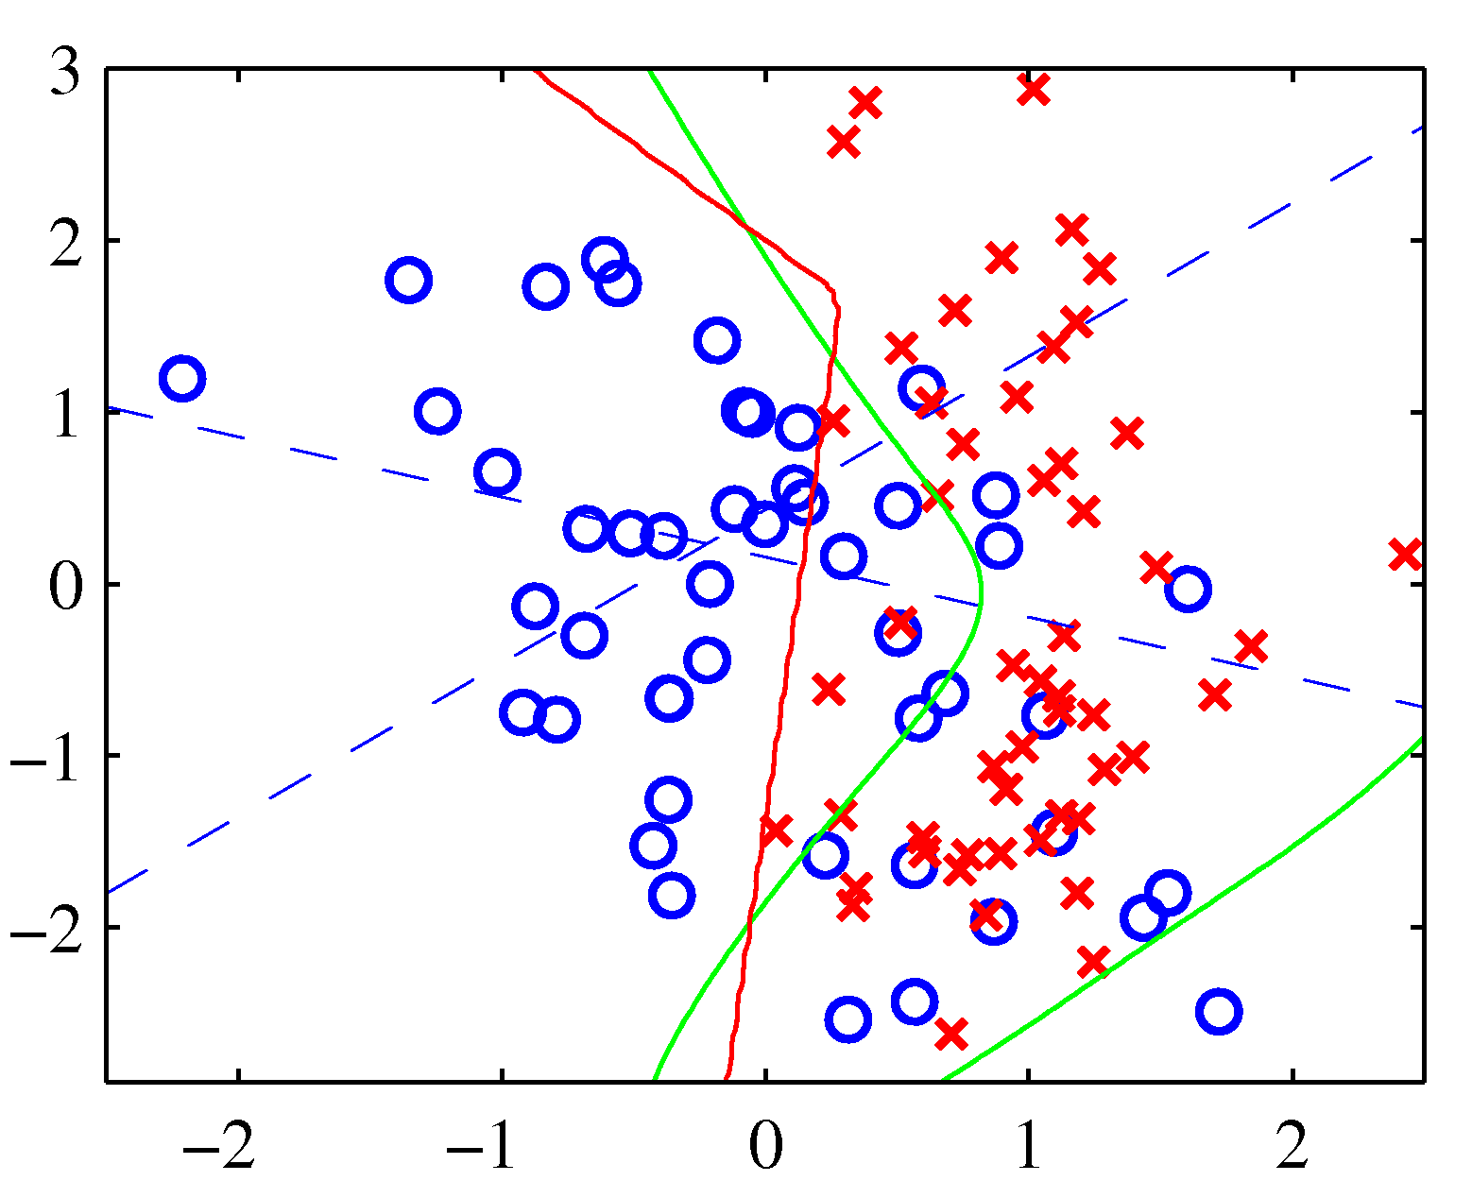
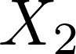
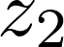
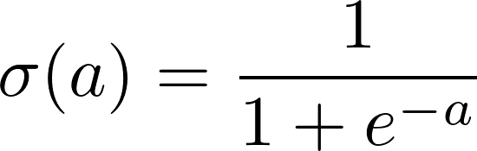
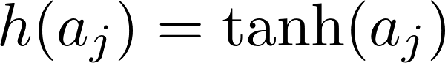
Binary Classification Example
*
*Pattern Recognition and Machine Learning, C. M. Bishop, Springer, 2006, pg. 232.
Neural Networks
Özgür Martin

Slide 5
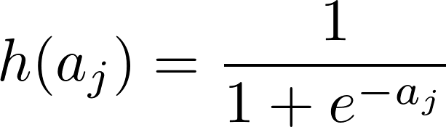
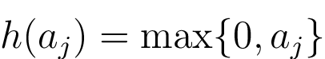
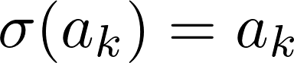
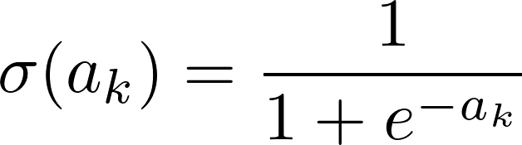
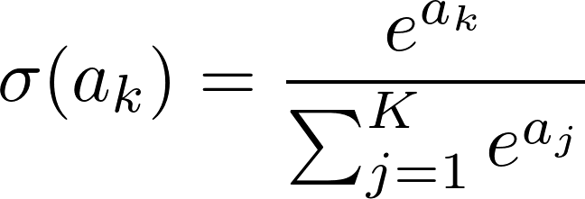
Activation Functions
Sigmoid Function
“tanh” Function
Rectified Linear Unit (ReLU)
Identity Function
Sigmoid Function
Softmax Function
Neural Networks
Özgür Martin

Slide 6
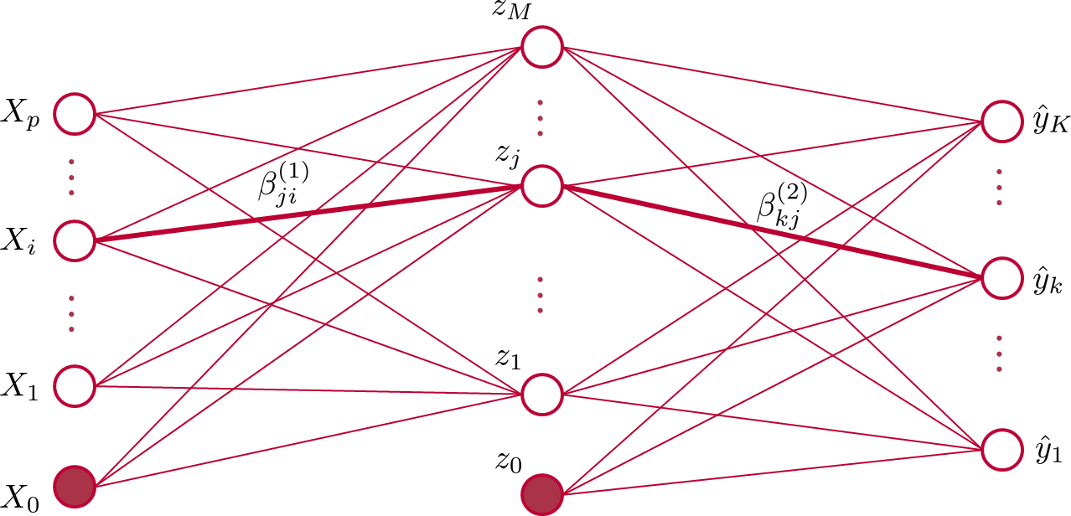
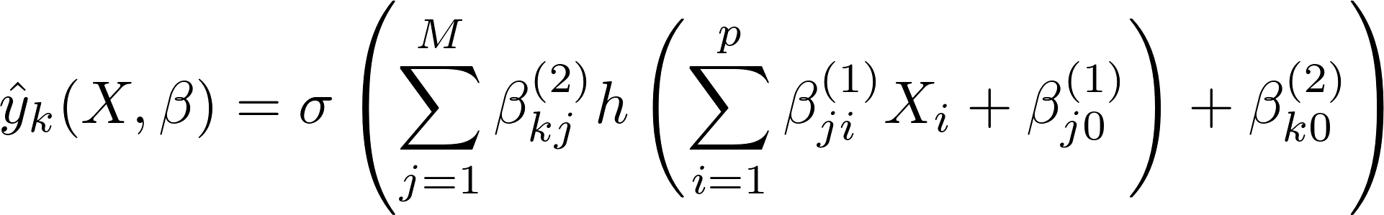
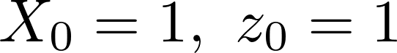
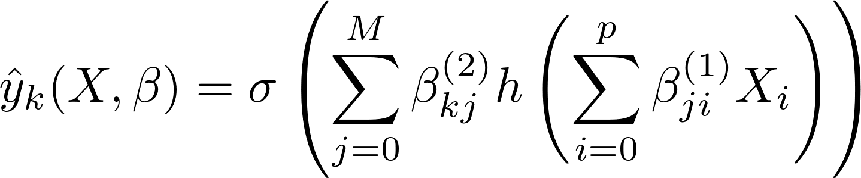
Network Function
Neural Networks
Özgür Martin

Slide 7


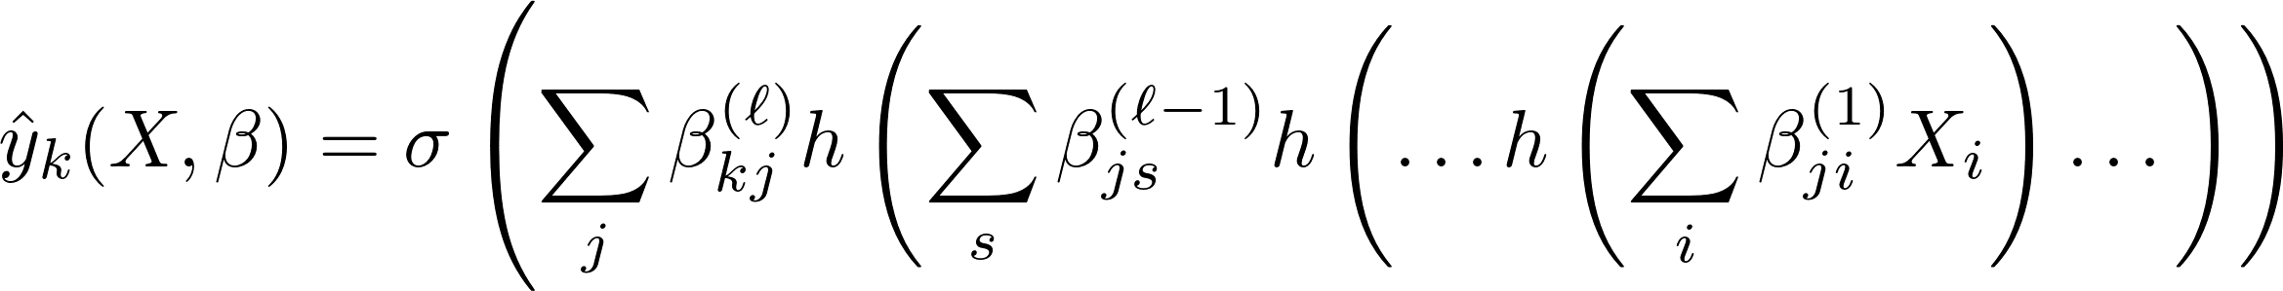
Network Function
. . .
. . .
. . .
. . .
. . .
Multiple Hidden Layers
Neural Networks
Özgür Martin

Slide 8
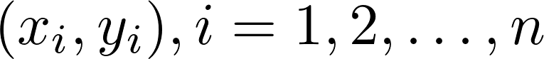
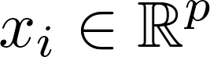
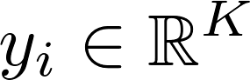
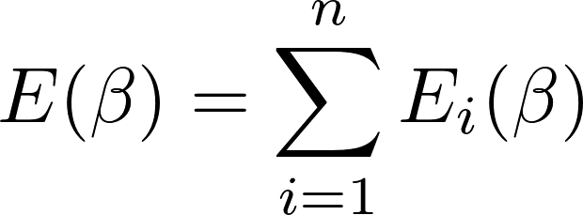
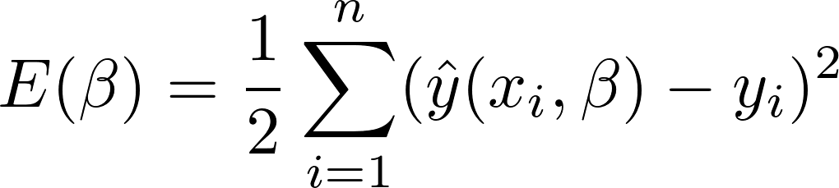
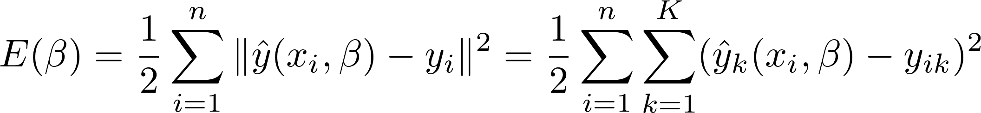
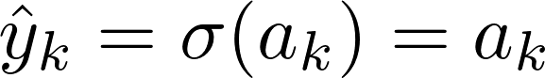
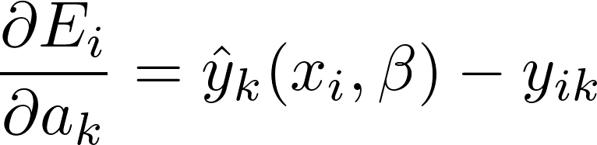
Network Training Error Functions Regression
Sum of Squares
K = 1
K > 1
Neural Networks
Özgür Martin

Slide 9
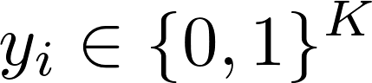



Network Training Error Functions K-Separate Binary Classification
Cross Entropy
K = 1
K > 1
Neural Networks
Özgür Martin

Slide 10



Network Training Error Functions Multiclass Classification
Cross Entropy
Neural Networks
Özgür Martin

Slide 11

Network Training Optimization
(Batch) Gradient Descent
k : iteration
$∝_{k}$ : learning rate
Stochastic Gradient Descent (SGD)
Mini-batch SGD
Neural Networks
Özgür Martin

Slide 12



Network Training Backpropagation
Recall
Apply chain rule over and over again?
Yes but try it on the network!
Neural Networks
Özgür Martin

Slide 13












Network Training Backpropagation
. . .
. . .
t
u
s
. . .
Neural Networks
Özgür Martin

Slide 14

Network Training Backpropagation
Neural Networks
Özgür Martin

Slide 15

Network Training Backpropagation
Apply an input vector x_{i} and propagate it through the network using
Evaluate the following for the output units:
Backpropagate the following for the hidden units:
Evaluate the components of the gradient:
Neural Networks
Özgür Martin

Slide 16














Network Training
$$l=1,2,…,L$$
$$a_{n_{2}}^{[2]}$$
$$z_{n_{2}}^{[2]}$$
$$a^{[l]}=(a_{0}^{\left[l\right]},a_{1}^{\left[l\right]},…,a_{n_{l}}^{[l]})$$
$$z_{p}^{[1]}$$
. . .
$$a_{i}^{\left[l\right]}= \sum_{j=0}^{n_{l−1}}{β_{ji}^{(l−1)}z_{j}^{\left[l−1\right]}}$$
$$a_{2}^{[2]}$$
$$z_{2}^{[2]}$$
. . .
$$z_{i}^{[1]}$$
. . .
$${a^{[l]}=W}^{[l−1]}z^{[l−1]}$$
. . .
. . .
$$z_{1}^{[1]}$$
$$a_{1}^{[2]}$$
$$z_{1}^{[2]}$$
. . .
$$z^{[l]}=(z_{0}^{\left[l\right]},z_{1}^{\left[l\right]},…,z_{n_{k}}^{[l]})$$
$$z_{0}^{[1]}$$
$$z^{[l]}=h(a^{[l]})$$
Hidden Layer
Neural Networks
Özgür Martin

Slide 17



For counter 1 upto Niter
Choose an integer k uniformly at random from {1, 2, …, N}
$x_{k}$ is current training data point
$z^{[1]}=x_{k}$
For $l=2$ up to $L$
$a^{[l]}=W^{[l−1]}z^{[l−1]}$
$z^{[l]}=h(a^{[l]})$
$D^{[l]}=diag(h′(a^{[l]}))$
end
$δ^{[L]}=D^{[L]}$($z^{[L]}−$ $y_{k}$)
For $l=L−1$ down to 2
$δ^{[l]}=D^{[l]}{(W^{[l]})}^{T}δ^{[l+1]}$
end
For $l=L−1$ down to 1
$W^{[l]}=W^{[l]}−ηδ^{\left[l\right]}{a^{\left[l−1\right]}}^{T}$
end
end
Network Training
Neural Networks
Özgür Martin

Slide 18
Network Training
GD vs. SGD
Gradient Descent
Stochastic Gradient Descent
Neural Networks
Özgür Martin

Slide 19

Network Training
Flat vs. Sharp Minima
*Keskar et al. 2017
Neural Networks
Özgür Martin

Slide 20

Network Training
Flat vs. Sharp Minima
Deep Convolutional
Neural Net on CIFAR-10
*Keskar et al. 2017
SGD
GD
Neural Networks
Özgür Martin

Slide 21
Analysis
Notation
Neural Networks
Özgür Martin

Slide 22
Analysis
Neural Networks
Özgür Martin

Slide 23
Analysis
Neural Networks
Özgür Martin

Slide 24
Analysis
Neural Networks
Özgür Martin

Slide 25
Analysis
Neural Networks
Özgür Martin

Slide 26
Analysis
Neural Networks
Özgür Martin

Slide 27
Analysis
Neural Networks
Özgür Martin

Slide 28
Analysis
Neural Networks
Özgür Martin

Slide 29
SGD Variants
Neural Networks
Özgür Martin

Slide 30



Optional Readings
Neural Networks
Özgür Martin

Slide 31


Network Training Overfitting
Cross validation
Dropout method: randomly deleting some nodes and their connections from the network (link)
Regularization
or
Neural Networks
Özgür Martin

Slide 32




Vanishing/Exploding Gradients
Gradient gets very small (large) moving from last layers to earlier layers
Training takes a long time or simply fails
Smaller initial weights lead to vanishing gradients
Larger initial weights lead to explosion of gradients
< 1
< 1
≤ 1
Neural Networks
Özgür Martin

Slide 33


Convolutional Neural Network (CNN)
Carefully constructed multi-layer neural network
Exploits the spatial structure of data (object recognition)
First layers learn simple patterns, subsequent layers recombine them
Hidden layers detect the same local structure
ReLU is used for activation
The number of weights and biases decreases significantly
Neural Networks
Özgür Martin

Slide 34

CNN - Construction
feature map
(uses ReLU)
local receptive fields (5×5)
stride length (one)
input: 20 × 30 neurons
16 × 26 neurons
weights and bias are shared for each hidden neuron
(shared weights and bias define a filter or a kernel)
Neural Networks
Özgür Martin

Slide 35
CNN – Hidden Layer
multiple feature maps
input: 20 × 30 neurons
first hidden layer: 4 × 16 × 26 neurons
(convolutional layer)
number of weights and biases = (25 + 1) × 4 = 104
Neural Networks
Özgür Martin

Slide 36

CNN – Pooling Layer
max pooling
(maximum activation in the 2 × 2 region)
first hidden layer: 4 × 16 × 26 neurons
second hidden layer: 4 × 8 × 13 neurons
(pooling layer)
Neural Networks
Özgür Martin

Slide 37
CNN – Merging Layers
20 × 30
4 × 16 × 26
4 × 8 × 13
Neural Networks
Özgür Martin

Slide 38


CNN – Complete Network
input
convolution
pooling
classification
(fully connected NN)
Common to use one layer for classification in the last stage
There could be multiple convolution layers
Too many matrix or vector multiplications are required
Vectorization along with GPUs are used (for all deep learning networks)
Neural Networks
Özgür Martin

Slide 39

CNN – Object Recognition
(source)
Neural Networks
Özgür Martin

Slide 40

CNN – ImageNet Classification
(source)
Neural Networks
Özgür Martin

Slide 41

Autoencoders
Unsupervised learning
Motto: Extract features, reconstruct input
Dimension reduction technique
(source)
Neural Networks
Özgür Martin

Slide 42








Autoencoders
encoder
decoder
. . .
. . .
. . .
. . .
. . .
. . .
sigmoid functions
Neural Networks
Özgür Martin

Slide 43


(source - 2016)
Neural Networks
Özgür Martin

